Slide 1
Professional Practices
Cyber Ethics & Cybercrime
Hacking | Fraud | Scams | Law & Order | Sociotechnical Security | Computer Crime and Cyber Laws
Presented by Maham Noor
Lecturer
University of Central Punjab

Slide 2
Content of this week | CLO | Week
Computer and Internet Crime Hacking and the Hacker Ethics, Theft and Credit Card Fraud, Scams & Forgery, Law and Order on the Internet Sociotechnical Order Sociotechnical Security Example cases from Pakistan on Hacking, scams and Forgery etc. | 2 | 6
Cyber laws of Pakistan What initiatives Pakistan has taken to control cyber crime National Response Center for cybercrime and its responsibilities Activity: Cyber ethics and law in action Role Play

Slide 3
Hacking

Slide 4
Hacking
Hacking is the act of gaining unauthorized access to a computer system, network, or digital device
Example:
In 2019, a group of Pakistani hackers allegedly carried out cyberattacks on several Indian banks, stealing data from credit cards and online banking systems. The attackers reportedly sold the stolen information on the dark web — an online black market where illegal data is traded.

Slide 5
Types of Hacking
Ethical Hacking (White Hat)
Done legally with permission to find and fix security flaws.
Example: Cybersecurity experts testing a company’s system.
2. Black Hat Hacking
Illegal hacking for personal gain or harm — such as stealing data, spreading viruses, or crashing systems.
Grey Hat Hacking
Hackers who break into systems without permission but don’t intend harm — they might expose flaws to the company or public.

Slide 6
Common Hacking Techniques
Phishing: Tricking users into giving personal information (like passwords).
Malware: Inserting malicious software (viruses, worms, ransomware).
SQL Injection: Exploiting database vulnerabilities.
Denial of Service (DoS): Overloading a system to make it unavailable.
Password Cracking: Guessing or stealing passwords.

Slide 7
Purpose of Hacking
To steal confidential information (like credit card data or personal files)
To damage or disrupt systems
To protest (hacktivism)
To test security and strengthen systems (ethical reasons)

Slide 8
Hacker ethics
Hacker ethics emphasize that hacking should be used for learning, problem-solving, and security improvement, not for crime or harm.
It’s about being curious, responsible, and honest while using technology.
Example
A white hat hacker finds a security flaw in a bank’s website and reports it to the bank instead of stealing data — this follows hacker ethics.

Slide 9
Theft & Credit Card Fraud
In cybersecurity, theft means stealing digital assets or information such as money, data, or identity through unauthorized access to computer systems or networks.
Examples:
Stealing customer data from a bank database
Copying confidential business information without permission

Slide 10
Scams & Forgery
A scam is a fraudulent scheme or deceptive act used to trick people into giving away money, personal information, or access to accounts.
It usually involves false promises, fake identities, or manipulative messages to gain trust.
Examples:
Online Shopping Scam: Fake websites offering cheap products but never delivering them.
Phishing Scam: Emails or texts pretending to be from a bank or company asking for passwords or credit card details.
Lottery or Prize Scam: Messages claiming you’ve won a prize, asking for “fees” or personal details to claim it.

Slide 11
Law and Order on the Internet
Law and Order on the Internet refers to the legal rules, regulations, and enforcement mechanisms that ensure:
The protection of digital rights,
Prevention of cybercrimes,
Maintenance of ethical behavior online.
Example
1. Pakistan – Prevention of Electronic Crimes Act (PECA 2016)
This law deals with cybercrimes such as hacking, harassment, identity theft, fake news, and online defamation. It gives legal powers to FIA’s Cyber Crime Wing to investigate and punish offenders.
2. India – Information Technology (IT) Act 2000
Covers offenses like unauthorized system access, data theft, and cyber fraud, and gives legal recognition to digital signatures and e-documents.

Slide 12
Sociotechnical Order
Sociotechnical Order means maintaining order and harmony between human activities and technological systems to ensure safe, efficient, and ethical use of technology.
Example
to detect hate speech, fake news, or harmful content on Facebook or other social platforms.

Slide 13
Components of Sociotechnical Order
Social Aspect:
  People, organizations, laws, culture, and ethics.
  How users behave, communicate, and follow rules online.
Technical Aspect:
  Computers, networks, software, and security systems.
  How technology is designed, maintained, and controlled to support society’s needs.

Slide 14
Computer Crime/ Cyber Crime and Cyber Laws in Pakistan

Slide 15
Cyber Crime
Cyber crime refers to any illegal activity that involves a computer, network, or the internet.
It is a crime in which computers are used as tools, targets, or both — to steal data, harm systems, or commit fraud.
Examples:
  E-mail account of a Federal Minister is hacked.
  Credit cards frauds reach to an alarming level.
  Visiting CEOs of Multinational Companies gets threatening E-mails.
  Financial institutions are the favorite targets of Cyber criminals --- worst effecting the technological
  progress in the area of e –Commerce
Notes:
characteristic of the culture of computers, information technology, and virtual reality.
"the cyber age"
We are living in cyber age.

Slide 16
Cyber stalking
means repeatedly bothering or scaring someone online.
Example
A person constantly sends unwanted messages, comments, or threats to someone on Facebook or Instagram — even after being blocked — this is cyber stalking.

Slide 17
Spamming
spamming means flooding someone’s inbox or account with junk messages.
Examples:
Receiving dozens of unwanted marketing emails from unknown senders.
Spam comments on social media promoting fake websites.
Emails containing malicious links pretending to offer free prizes or discounts.

Slide 18
Cyber terrorism
cyber terrorism means using computers and the internet to cause harm or spread terror.
Examples
Hacking government websites to leak or destroy sensitive information.
Launching cyber-attacks on airports, banks, or national security systems.
Spreading propaganda or fake news to incite violence or hatred.
Disabling power systems or communication networks during conflicts.

Slide 19
Difference between hacking and cybercrime
Aspect | Cyber Crime | Hacking
Definition | Any illegal activity using computers, networks, or the internet. | The act of breaking into computer systems or networks without permission.
Scope | Broader term — includes all types of digital crimes. | Narrow term — one method used to commit cyber crime.
Purpose | To steal data, money, spread viruses, harass, or damage systems. | To gain unauthorized access — sometimes for theft, sabotage, or testing security.
Legality | Always illegal and punishable by law. | Can be illegal (black hat) or legal (ethical hacking) when done with permission.
Examples | Phishing scams, identity theft, cyberbullying, ransomware attacks. | Accessing someone’s account or system without permission.
Main Focus | Covers all digital offenses and their effects. | Focuses only on unauthorized access or control of systems.

Slide 20
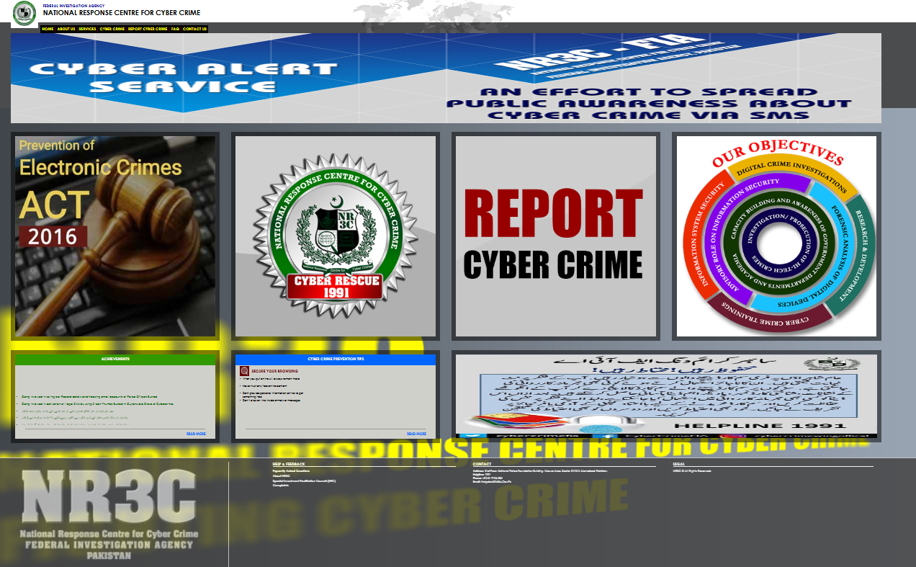

Slide 21
Cyber Laws
Cyber laws is an attempt to apply laws designed for the physical world to human activity on the Internet
Example
Electronic Commerce Act (Ireland)
Electronic Transactions Act (UK, USA, Australia, New Zealand, Singapore)
Electronic Transactions Ordinance (Hong Kong)
Information Technology Act (India)
Information Communication Technology Act Draft (Bangladesh)

Slide 22
Cyber Laws in Pakistan
They are:
  Electronic Transaction Ordinance 2002
  Electronic / Cyber Crime Bill 2007
Notes:
Promulgated : Naqiz

Slide 23
1. Electronic Transaction Ordinance 2002

Slide 24
Electronic Transaction Ordinance 2002
The Electronic Transaction Ordinance (ETO) 2002 was Pakistan’s first cyber law, enacted to recognize and regulate electronic documents, digital communications, and online transactions.
Example
A person signing a contract using a digital signature or making an online purchase — both are legally recognized under the ETO 2002, just like traditional paper-based transactions.
Notes:
Ordinance : Urgent need ….President right ..but for 90 days

Slide 25
ETO 2002
Sections
  There are 43 sections in this ordinance
  It deals with following 8 main areas relating to e-Commerce.
    Recognition of Electronic Documents
    Electronic Communications
    Digital Signature regime and its evidential consequences
    Web Site & Digital Signatures Certification Providers
    Stamp Duty
    Attestation, notarization, certified copies
    Jurisdiction
    Offences
Notes:
Notarization provides assurance that a document is genuine, its signature is authentic, and the signer acted willingly and knowingly.
Jurisdiction is the official power to make legal decisions and judgments.

Slide 26
Important sections
36. Violation of privacy information | 37. Damage to information system, etc | 38. Offences to be non-bailable, compoundable and cognizable
gains or attempts to gain access to any information system with or without intent to acquire the information or Gain Knowledge Imprisonment 7 years (custody) Fine Rs. 1 million | alter, modify, delete, remove, generate, transmit or store information to impair the operation of, or prevent or hinder access to, information knowingly not authorized Imprisonment 7 years Fine Rs. 1 million | All offences under this Ordinance shall be non-bailable, compoundable and cognizable.

Slide 27
Pre-ETO 2002 | Post ETO 2002
No recognition of electronic documentation, electronic records and of evidential basis of documents/records. Failure to authenticate or identify digital or electronic signatures or forms of authentication No online transaction could be legally binding Electronic Data & Forensic Evidence not covered. No Rules | Electronic Documentation & Records recognized Electronic & Digital forms of authentication & identification given legal sanctity Messages through email, fax, mobile phones, Plastic Cards, Online recognized.

Slide 28
2. Electronic/Cyber Crime Bill 2007

Slide 29
Electronic/Cyber Crime Bill 2007
It was promulgated by the President of Pakistan on the 31st December 2007
It gives exclusive powers to the Federal Investigation Agency (FIA) to investigate and charge cases against such crimes.
Notes:
Forgery : illegally manipulate things

Slide 30
Electronic/Cyber Crime Bill 2007
The bill deals with the electronic crimes included:
  Cyber terrorism
  Data damage
  Electronic fraud
  Electronic forgery
  Unauthorized access to code
  Cyber stalking
  Cyber Spamming/spoofing

Slide 31
Punishments
Spreading false information about an individual:
  up to 3 years in prison or up to PKR 1 million in fine, or both
Making videos/taking photographs and distributing them without consent:
  up to 3 years in prison or up to PKR 1 million in fine, or both –
Electronic fraud: Use any data, electronic system or device or with intent to deceive any person
  7 years and/or 7 lac fine
Electronic Forgery: altering pictures, images, documents, and music perhaps.
  7years and/or 7 lac fine
Malicious code: transmits malicious code through an electronic system or device, Punishment:
  5 years and/or 5 Lac

Slide 32
Punishments
Cyber stalking: Commits the offence of cyber stalking.
  3 Years and 3 Lac
Spamming: whoever transmits harmful, fraudulent, or unsolicited electronic messages in bulk to any person 6 month
  50,000
Spoofing: with intent to gain unauthorized access or obtain valuable information
  3 Years and 3 Lac
Cyber terrorism attempts to engage in a terroristic act
  Death, life time jail
Notes:
گستاخ profane

Slide 33
Offence | Imprisonment (years) | Fine
Criminal Access | 3 | 3 Lac
Criminal Data Access | 3 | 3 Lac
Data Damage | 3 | 3 Lac
System Damage | 3 | 3 Lac
Electronic Fraud | 7 | 7 Lac
Electronic Forgery | 7 | 7 Lac
Misuse of Device | 3 | 3 Lac
Unauthorized access to code | 3 | 3 Lac
Malicious code | 5 | 5 Lac
Defamation | 5 | 5 Lac
Cyber stalking | 3 | 3 Lac
Cyber Spamming | 6 months | 50,000
Spoofing | 3 | 3 Lac
Pornography | 10 | -----
Cyber terrorism | Life | 10 Million

Slide 34
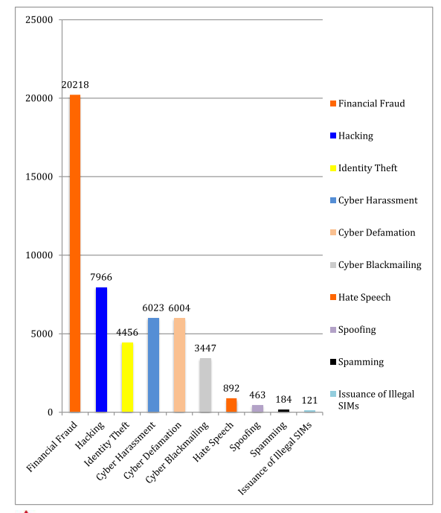
Crimes Reported in Pakistan
Notes:
What we should have to do?

Slide 35
Class Activity: Cyber Ethics & Law in Action
Scenario (Case Study)
A final-year Software Engineering student, Ali, develops a mobile banking app for his semester project. The app works smoothly, but Ali secretly adds a hidden feature that collects users’ CNIC numbers and credit card details and sends them to his personal server.
A few months later, some users face financial fraud. FIA’s National Response Centre for Cyber Crime (NR3C) traces the leak back to Ali’s app. He claims:
“It was just for testing.”
“I didn’t use the data for myself.”
“I didn’t know it was illegal since I am a student.”

Slide 36
1️⃣ Group Roles (4–5 students per group)
Prosecutors (Lawyers for FIA): Present why Ali’s actions are both unethical and illegal.
Defense (Ali’s side): Defend Ali’s actions with arguments (ignorance, intention, academic project).
Judges: Decide the verdict using Pakistan’s Cyber Crime Law (Electronic Transaction Ordinance 2002 / Cyber Crime Bill 2007).
Ethics Committee (Observers): Analyze the case from professional ethics codes (ACM/IEEE, PEC) and suggest how Ali should have acted.

Slide 37
2️⃣ Tasks for Each Role
Prosecutors:
  Identify the offence (e.g., Unauthorized Data Access, Electronic Fraud).
  Quote the relevant law and its punishment (e.g., up to 7 years & fine of 1 million PKR).
Defense:
  Argue why Ali should not face full punishment (student, ignorance, no intent).
Judges:
  Deliver a verdict: guilty or not guilty.
  Assign a punishment based on law.
Ethics Committee:
  Highlight the unethical aspect (violation of privacy, misuse of trust).
  Connect with ACM Code of Ethics (e.g., “Respect privacy”, “Avoid harm”).
  Suggest the right course of action for a responsible SE professional.

Slide 38
3️⃣ Debrief Questions for Class Discussion
What cybercrime law was violated here?
Does “ignorance” excuse Ali’s actions?
How could Ali have ethically handled user data?
As future software engineers, what professional responsibilities must you follow?

Slide 39
Outcomes:
After completing this activity, students will be able to:
Recognize unethical and illegal actions in software development.
Map actions in a case study to the relevant Pakistani cyber laws and their punishments.
Evaluate ethical issues using professional codes of ethics (ACM/IEEE, PEC).
Debate and justify decisions through structured role-play (prosecution, defence, judges, ethics committee).
Reflect on their own professional responsibility to protect privacy, ensure trust, and avoid harm.

Slide 40
Discussion and Questions

